Slide 1




Your OEM/EMS
solution provider
About us
Business Areas
Service Capability

Slide 2
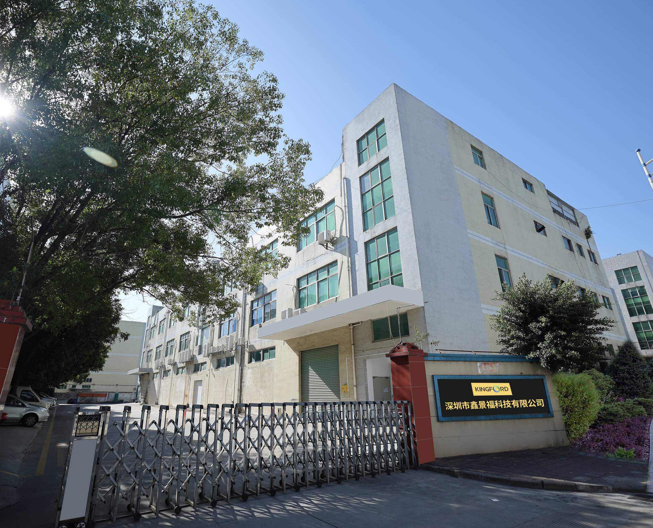




ART 01 - About us
Shenzhen Kingford Technology Co., Ltd. was founded in 1999, is a professional OEM/EMS manufacturer from China with more than 20 years experience.
Kingford committed to providing customers with high-quality requirements of one-stop services from components procurement, PCBA manufacturing, Turnkey assembly and so on.
"Digital-driven, Technology Empowerment and Shared philosophy" makes Kingford consistently improve its level of digital intelligence, and create values for customers and partners under the power of technology.
Employees
——
450+
Factory area
——
14000m²
Experience
——
20 years +
Delivery time
——
Flexible

Slide 3

ART 01 - About us /Company History
2023
Purchased Kingford own land in Thailand and already under the plan to build a factory to avoid tariff
2020
Carry out digitalization construction
of ERP, OA, WMS, MES, BI
1999
Founded at Hong Kong
Kingford
2018
Set up Shenzhen PCBA one-stop manufacturing plant
2021
Kingford PCBA new factory has put into operation, KFPCBA Platform got online and has been awarded with title-National high-tech enterprise
2019
Got certification of IATF16949, ISO13485, ISO9001, ISO14001, UL and IPC
2014
Became the shareholder of Well-Tech PCB factory

Slide 4
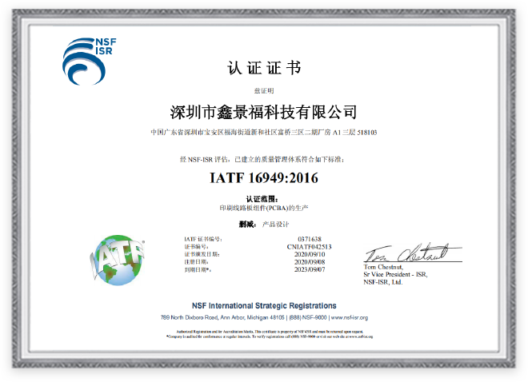
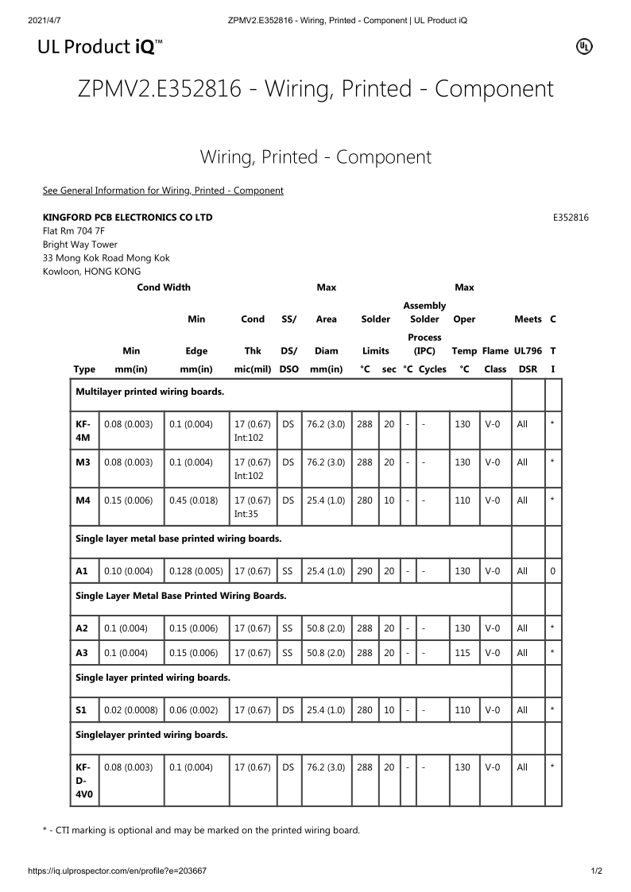
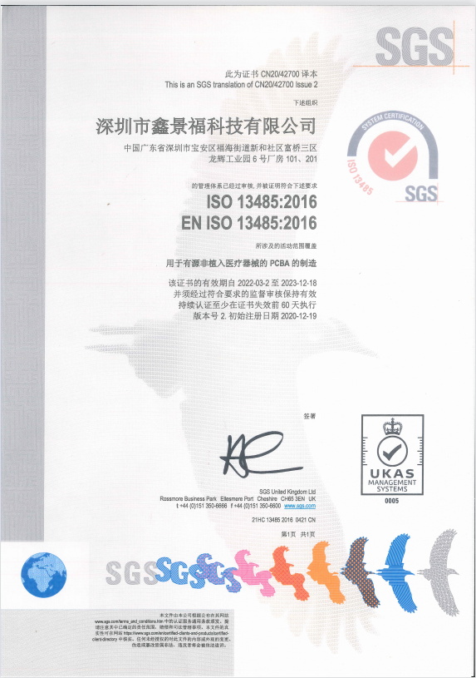
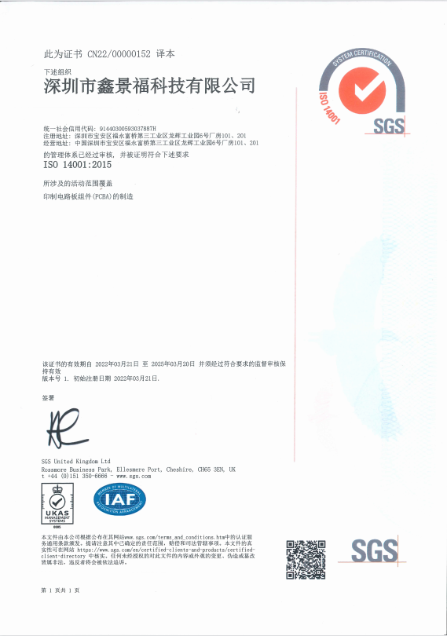
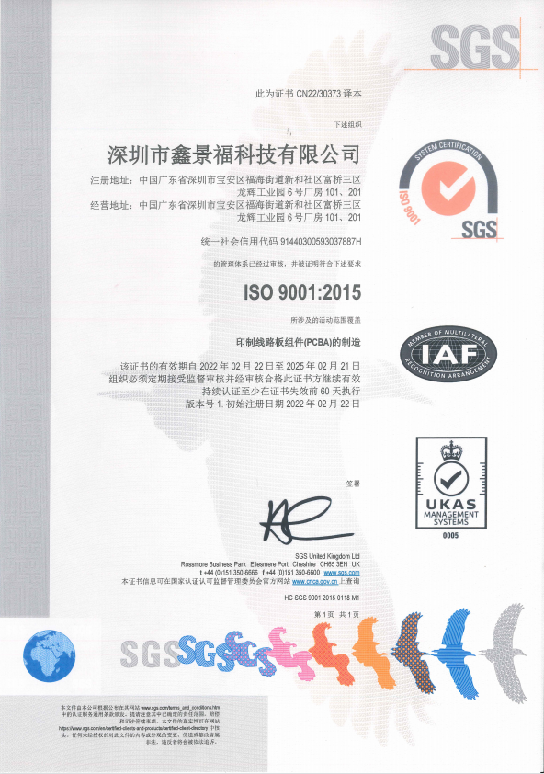
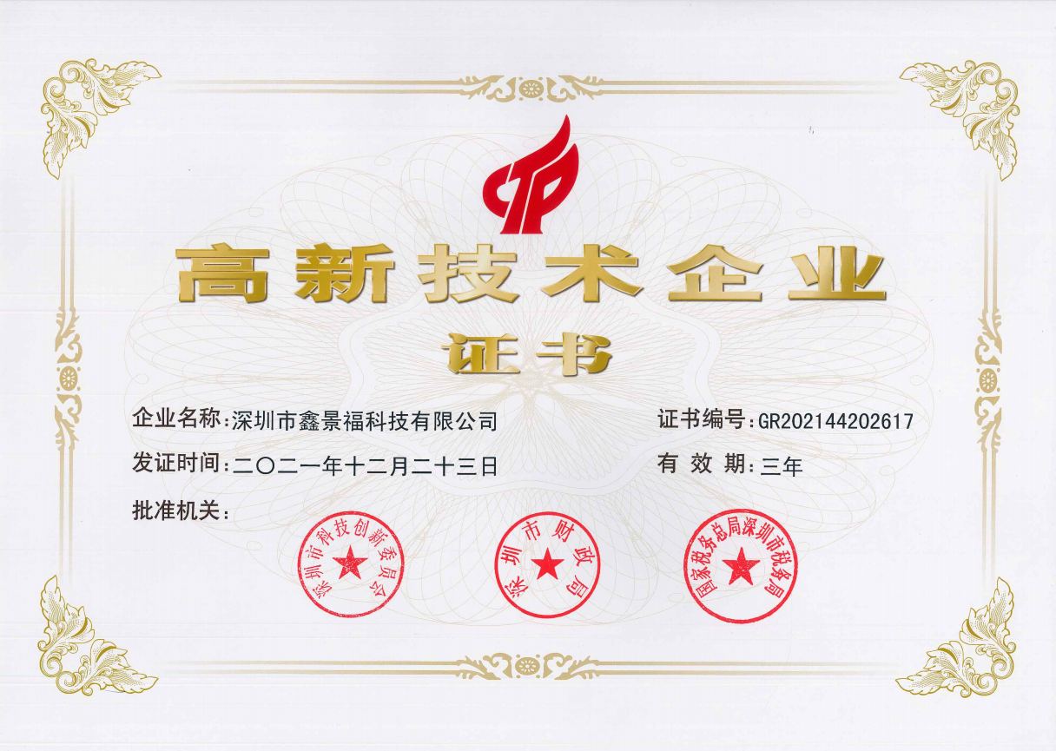
ART 01 - About us/ Quality certifications
[
IATF 16949:2016
new high-tech enterprise
UL(E352816)
ISO 13485:2016
ISO 9001:2015
ISO 14001:2015
Notes:
All of our certificates are obtained through SGS organization，is the most trustworthy

Slide 5










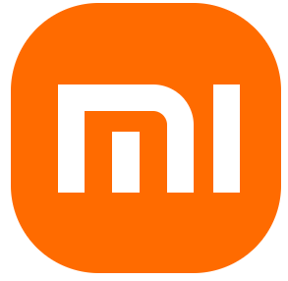



















ART 01 - About us /Our partners
cooperative partner
<<Suppliers
Clients>>
Notes:
Nordic 的芯片

Slide 6
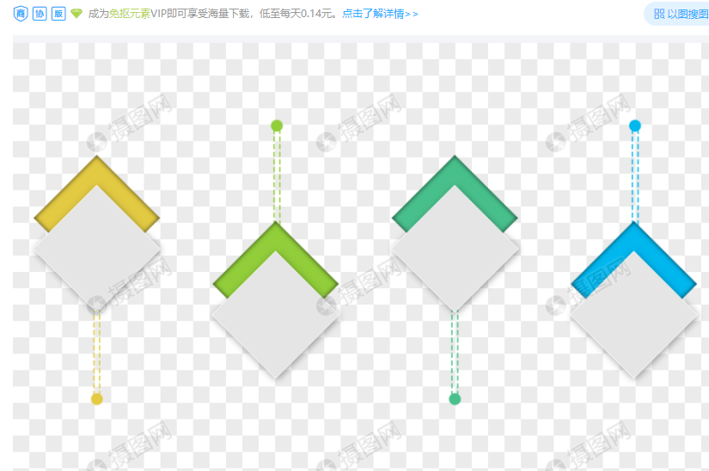
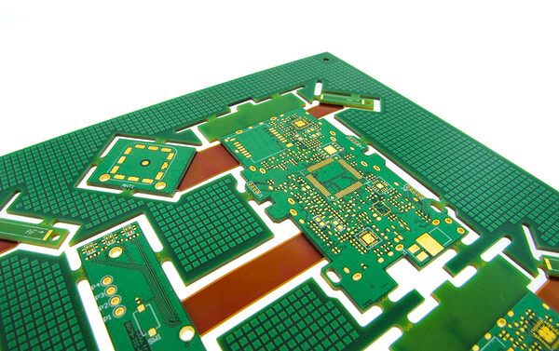
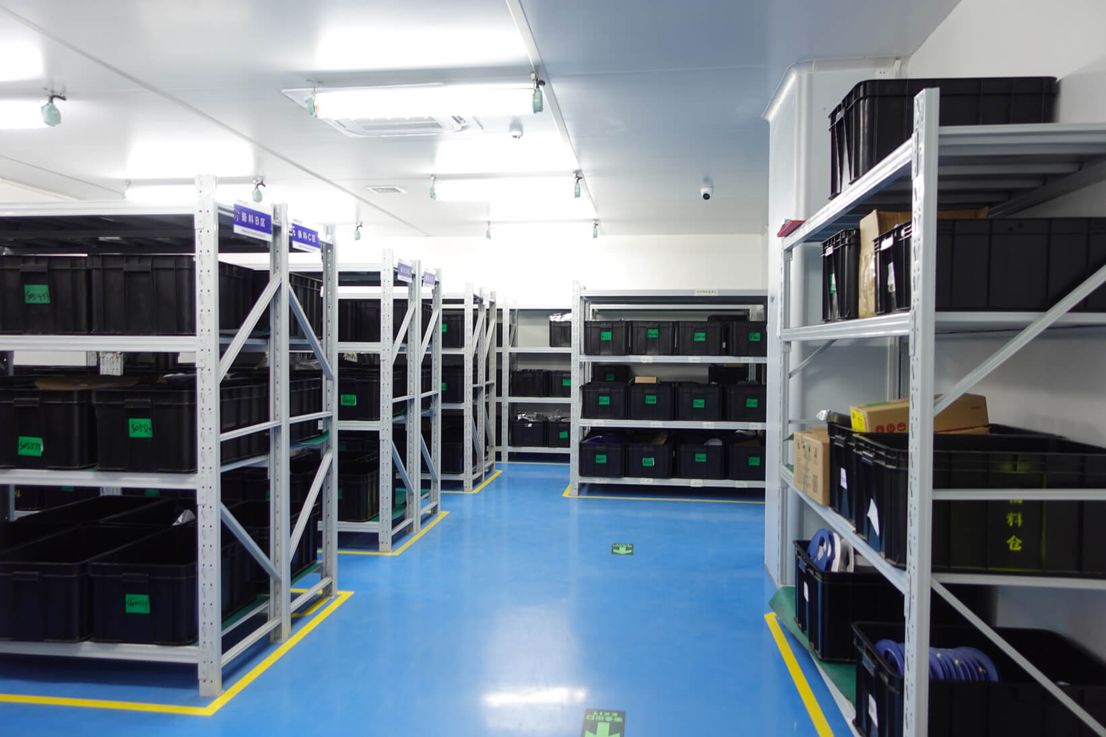
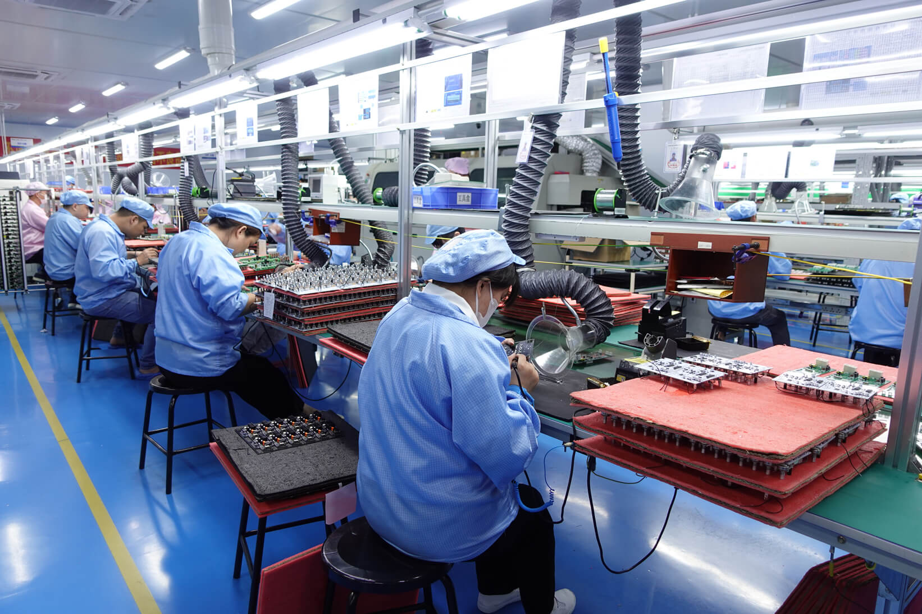
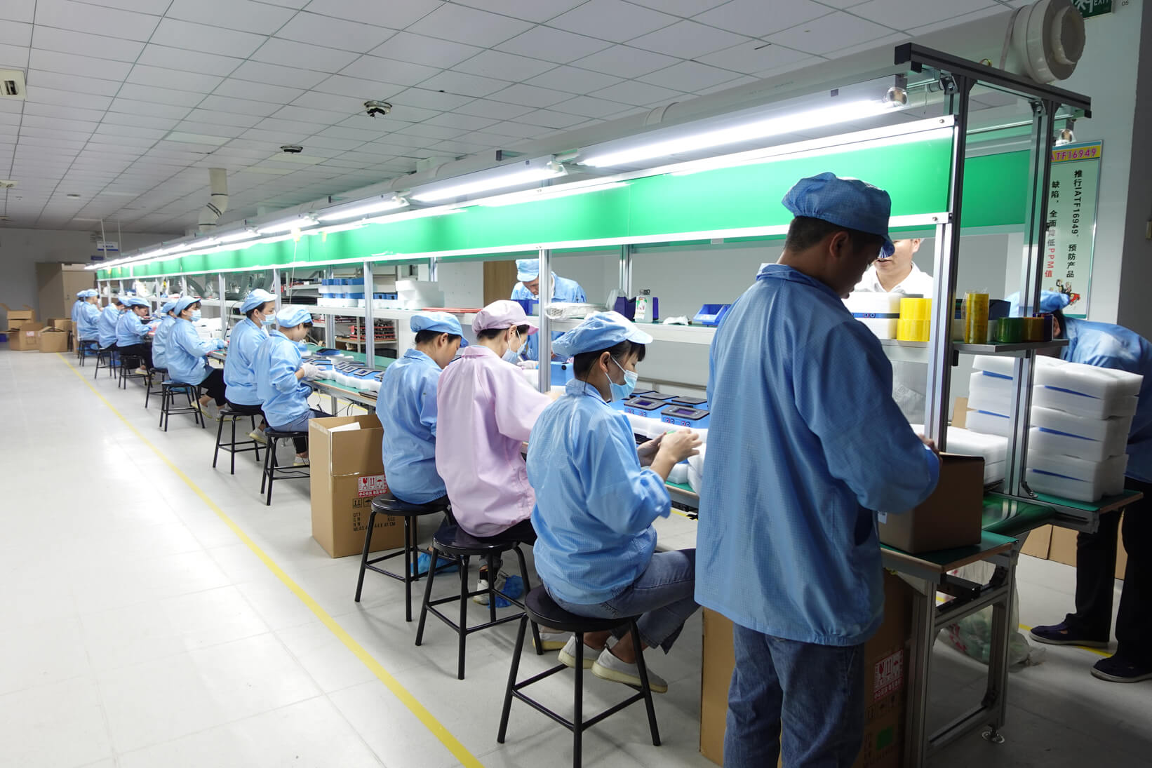
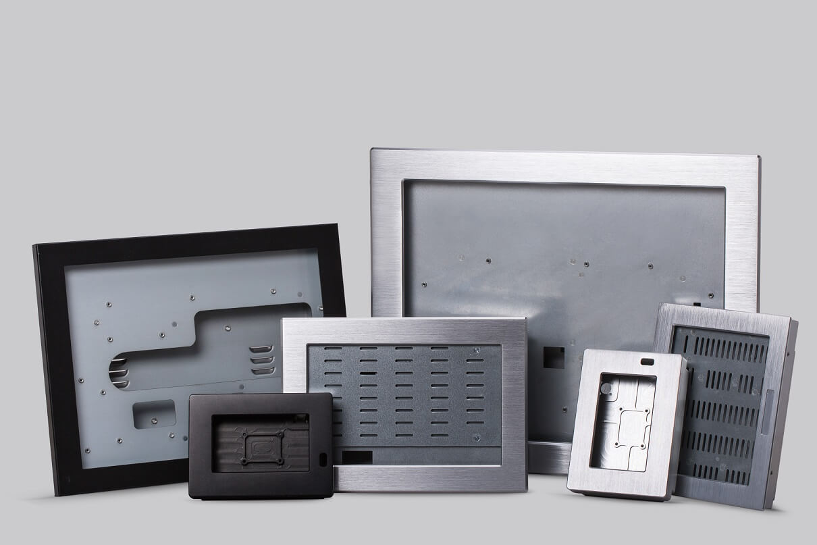
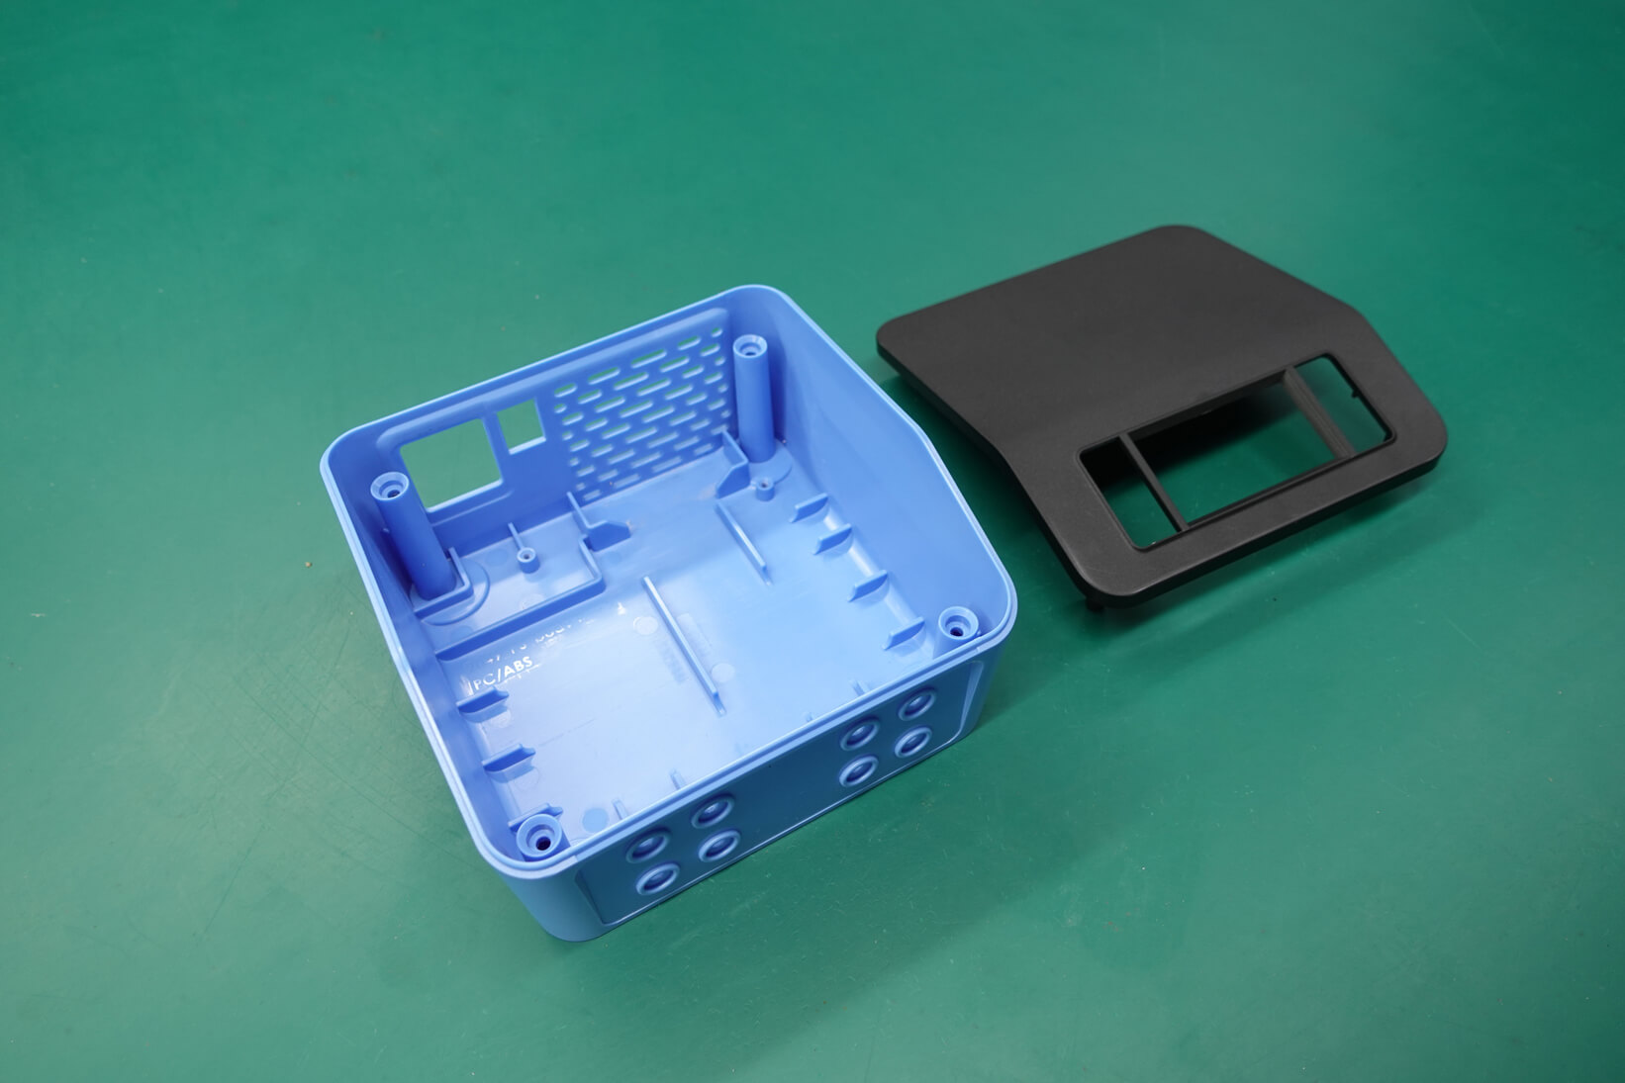
ART 02 - Business Areas
Kingford
Provide one-stop OEM/EMS services
>>PCB Layout and fabrication
>>Components Sourcing
>>PCBA assembly
>>Turnkey assembly
>>Metal stamping
>>Plastic injection

Slide 7
ART 02 - Business Areas /Sales Revenue
USD by million

Slide 8
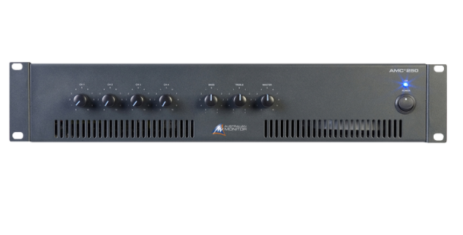
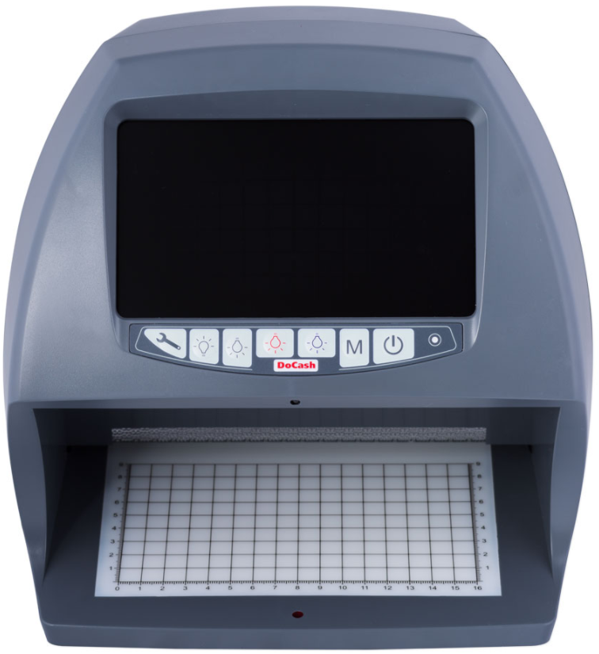
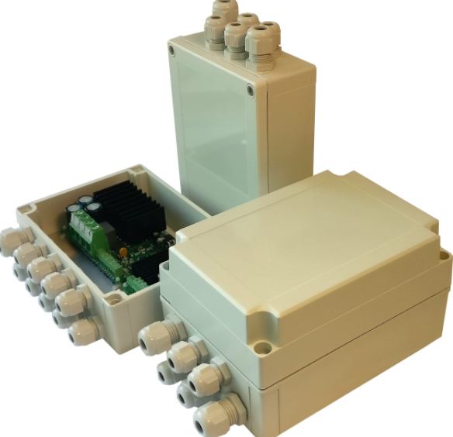
ART 02 - Business Areas /EMS business
Kingford is the professional EMS manufacturer, committed to providing customers with high-quality requirements of one-stop services from components procurement, PCBA manufacturing, Turnkey assembly and so on.
Permanent assets
4.5 millions
Engineering team
22 people
Workshop
14000㎡
Daily capability
500 million point

Slide 9



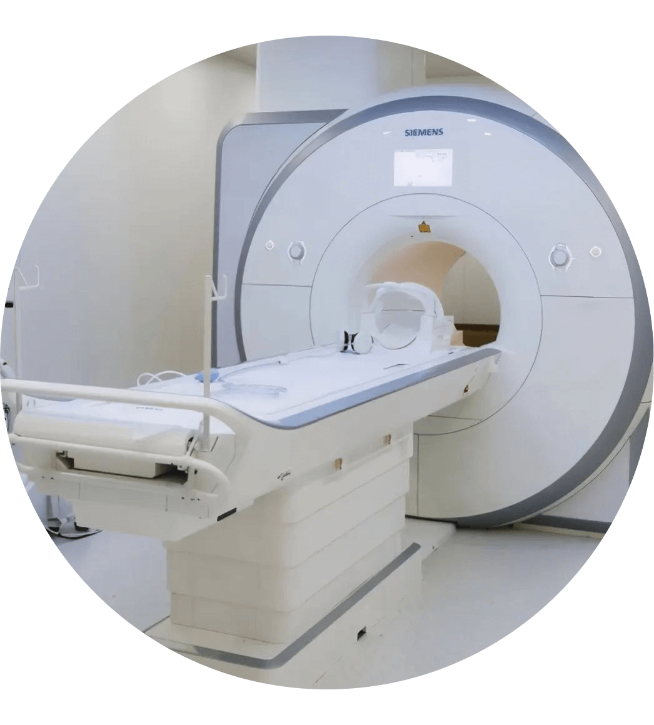


ART 03 - Service Capability
Automotive
Industrial
Security
Medical
Tele-communication
Consumer
Notes:
安防放在首页

Slide 10
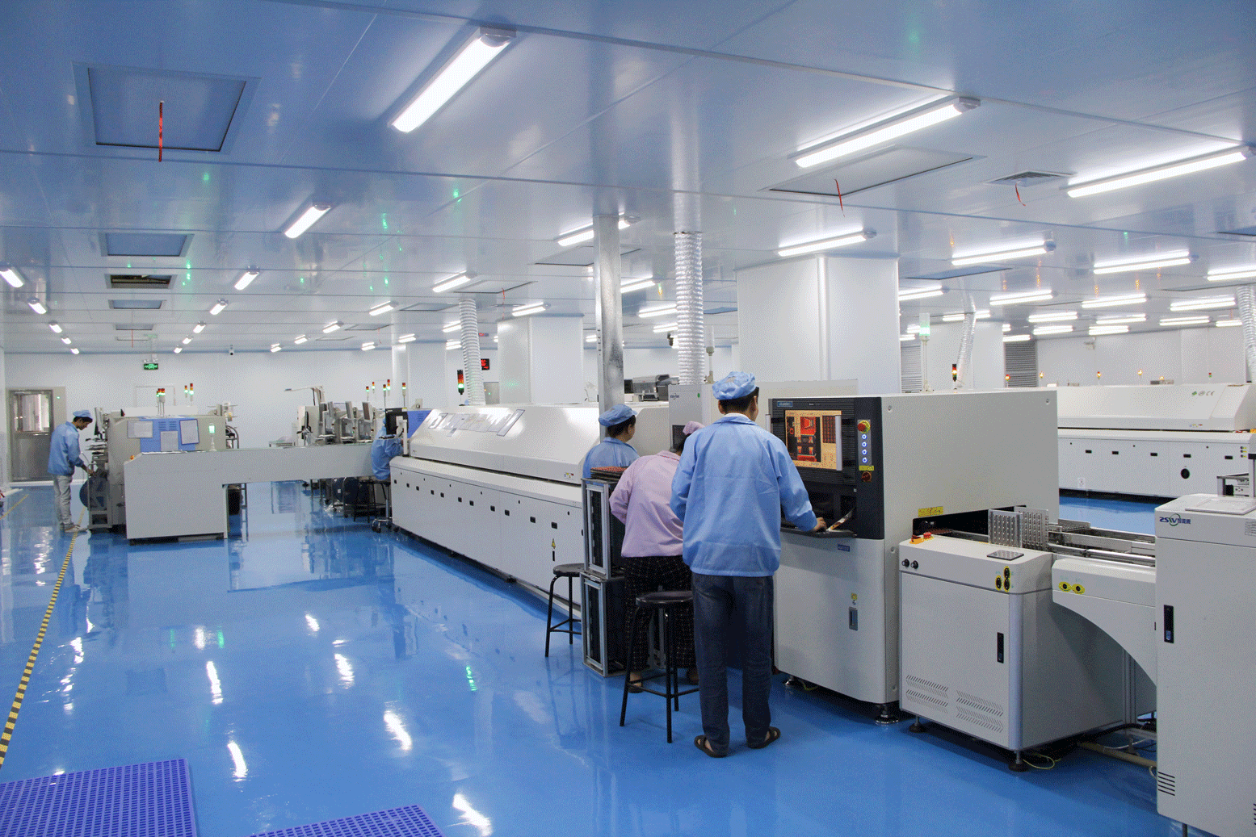
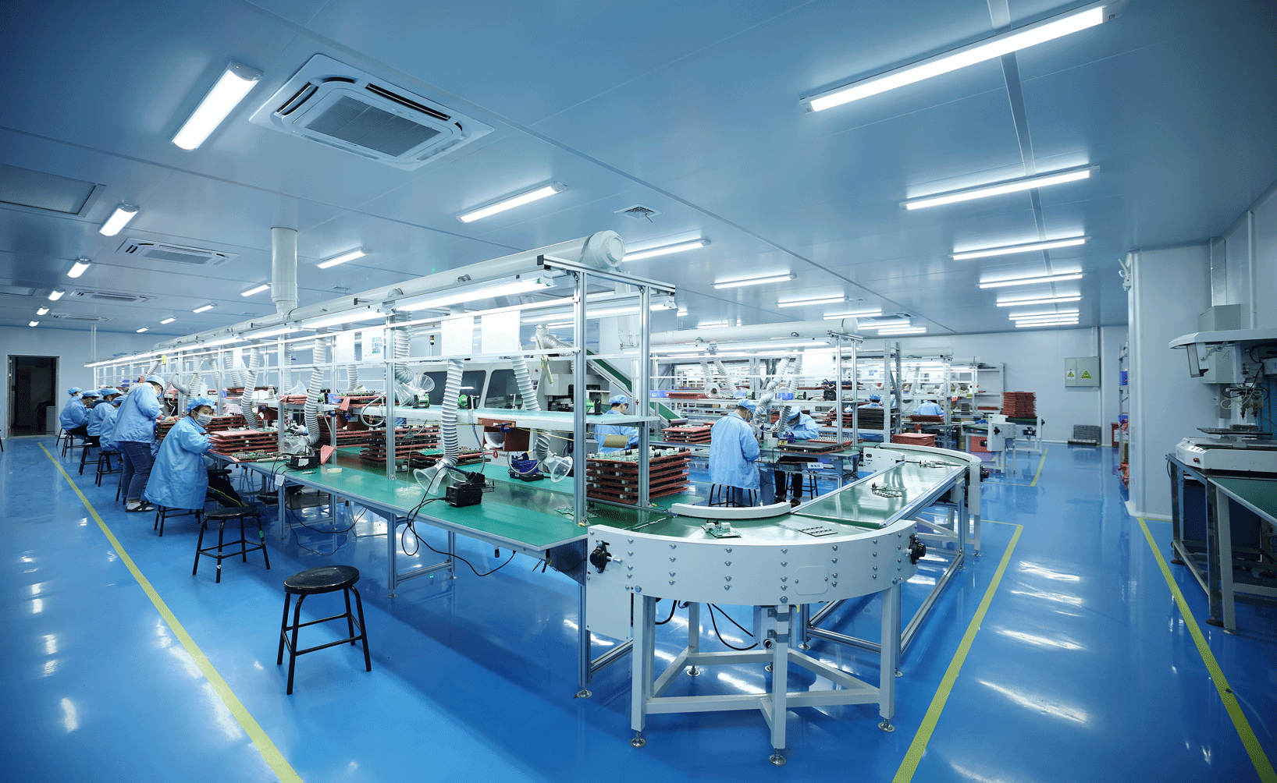
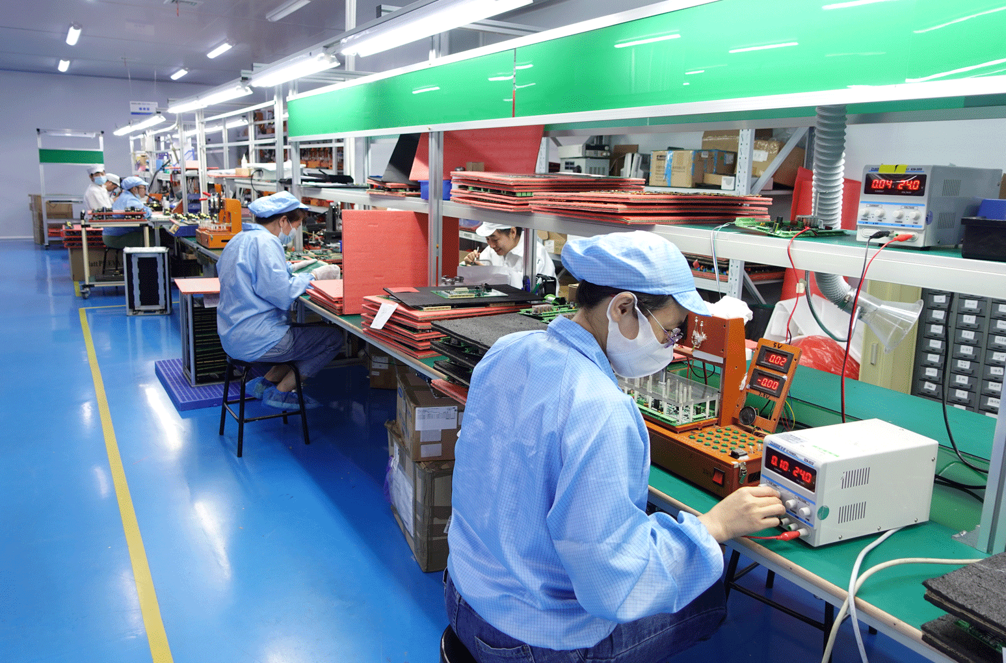
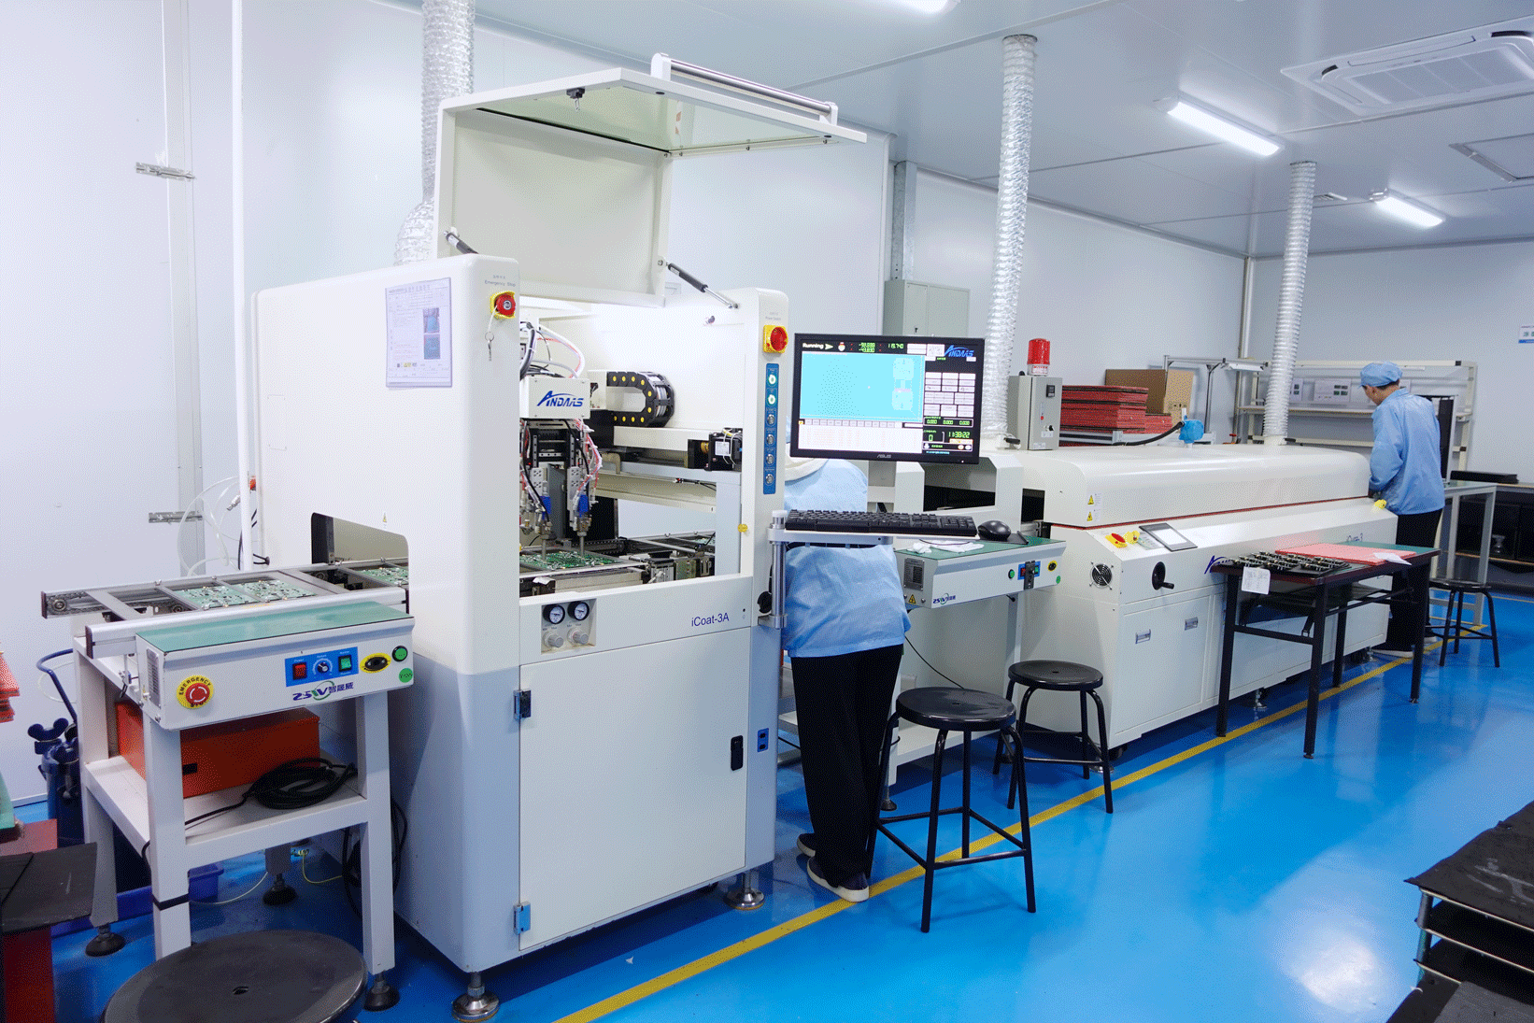
ART 03 - Service Capability /Turnkey product assembly lines
SMT production line
Through hole assembly production line
manual soldering line
Functional testing line
Turnkey assembly production line
Conformal coating line

Slide 11
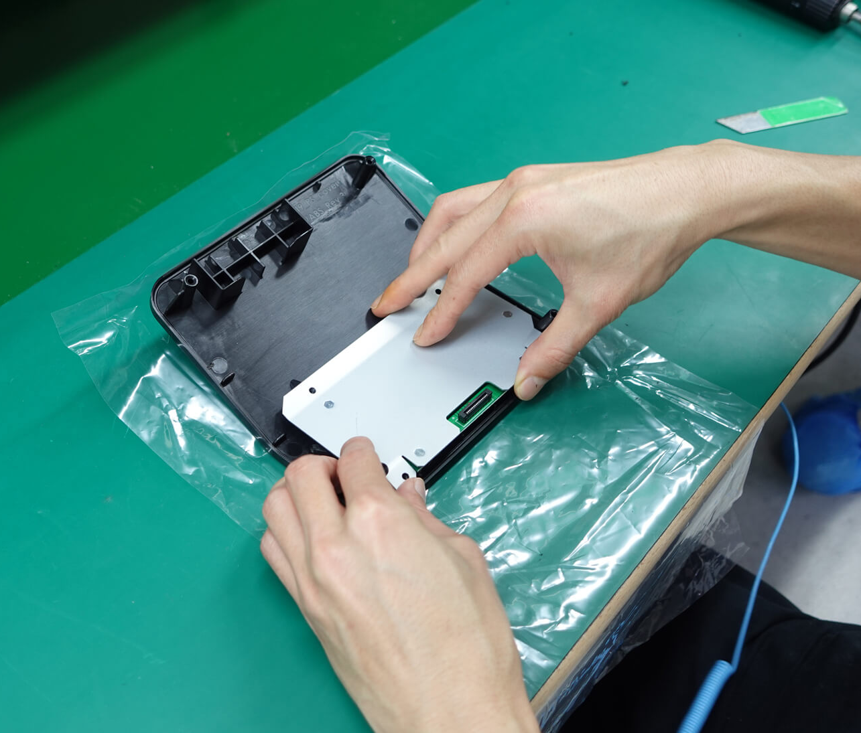
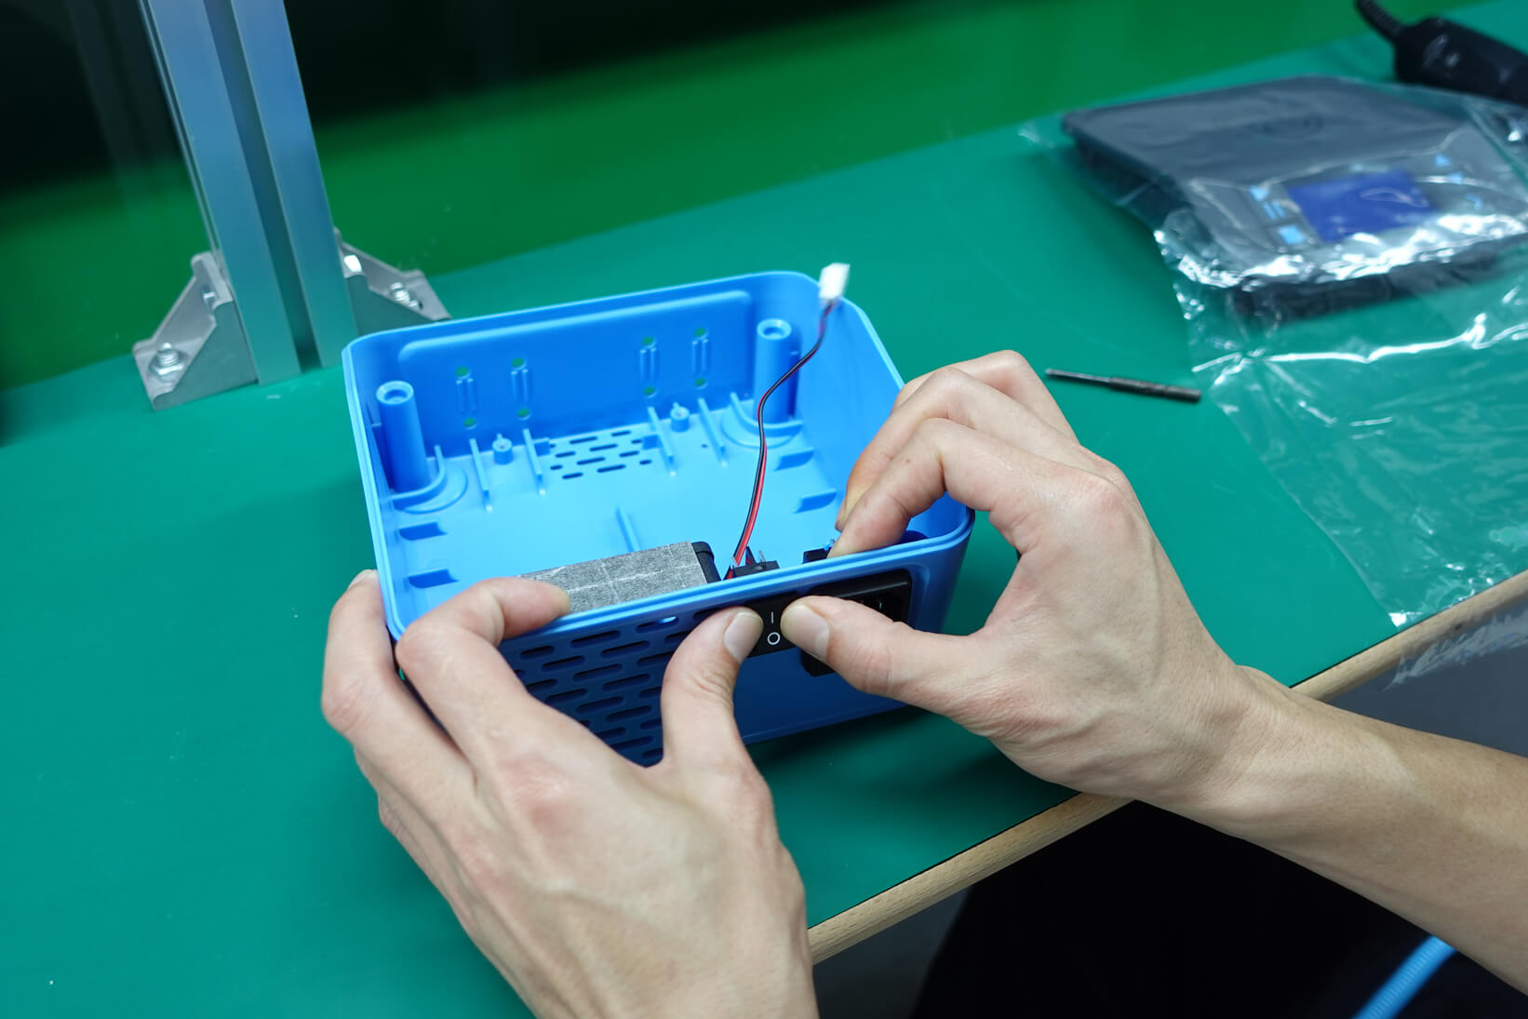
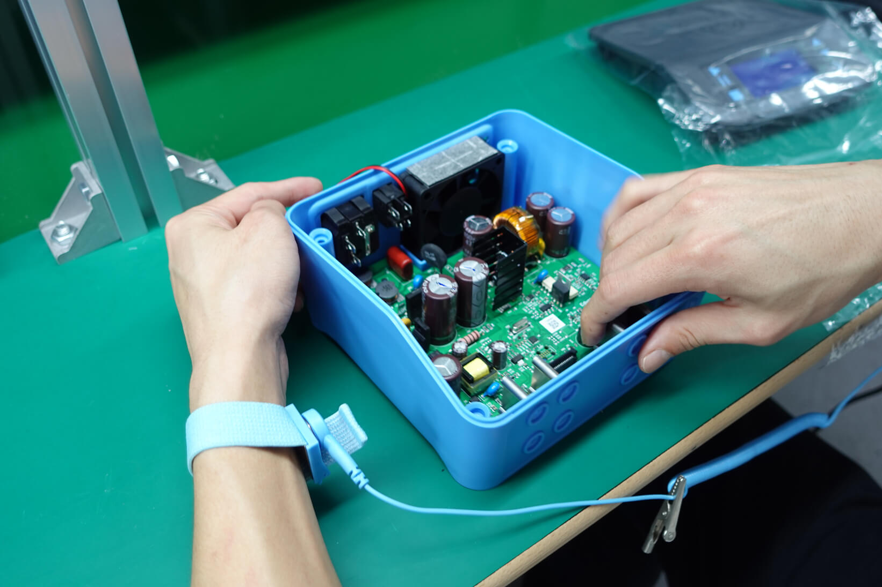
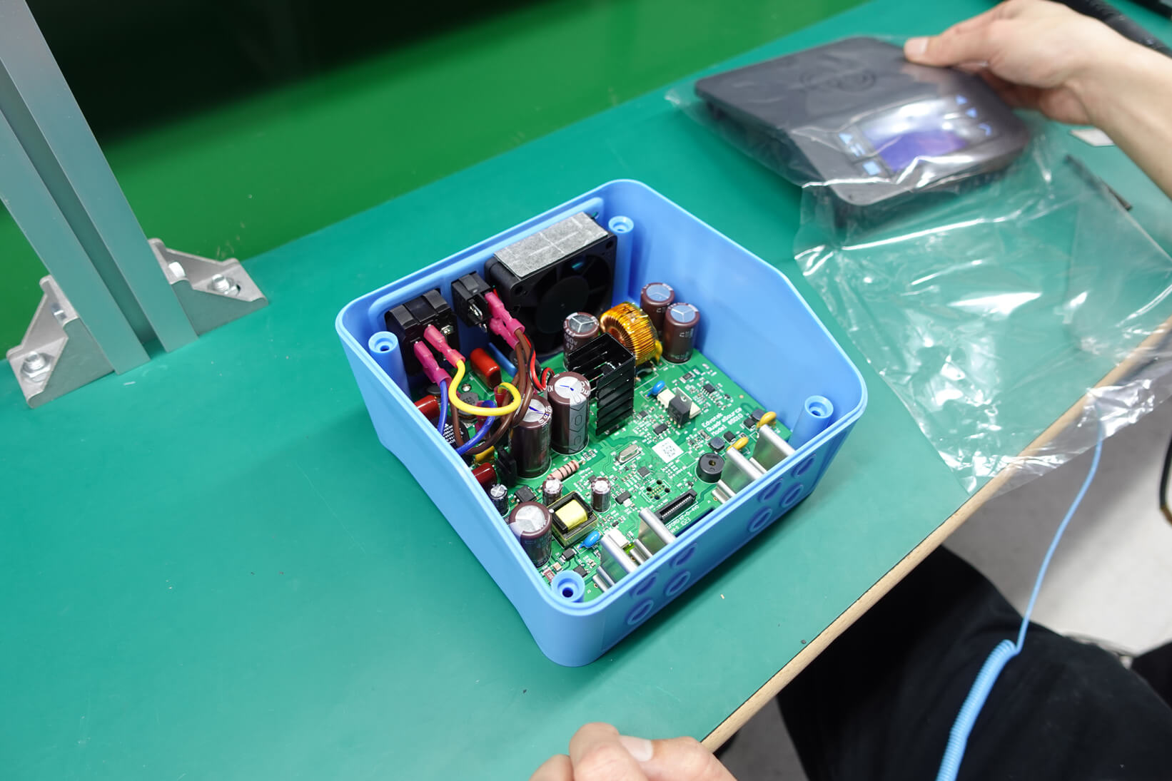
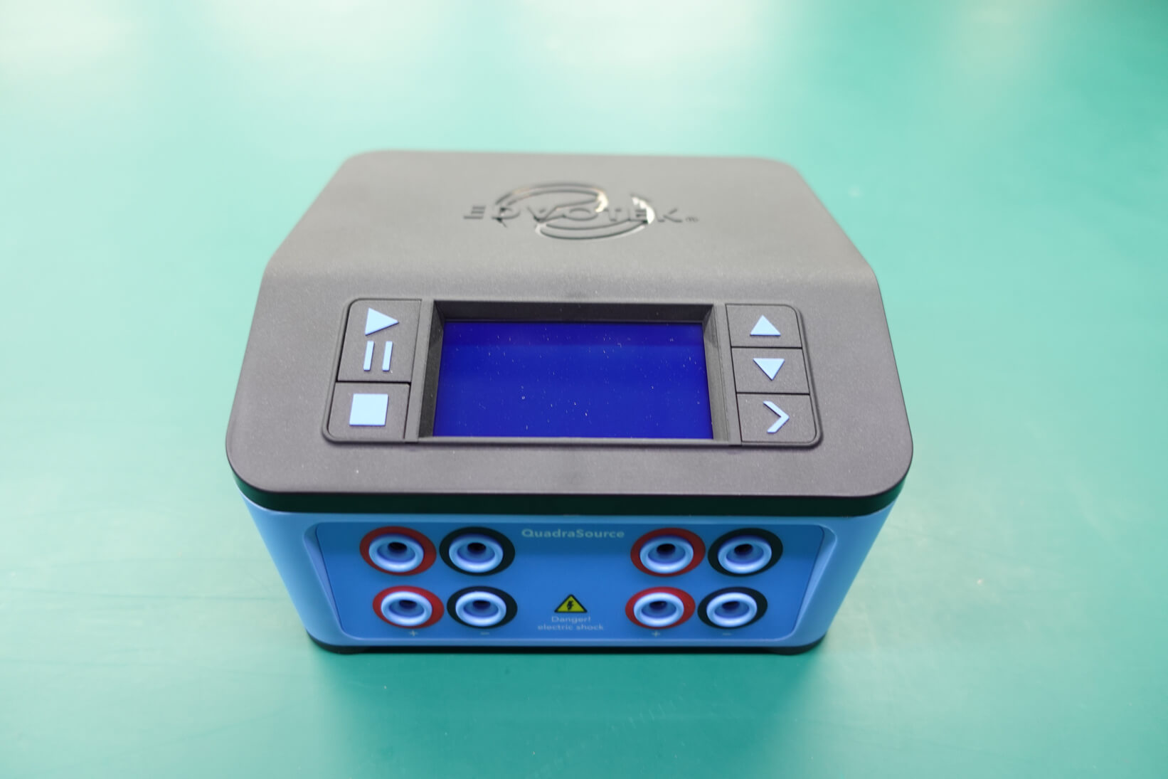
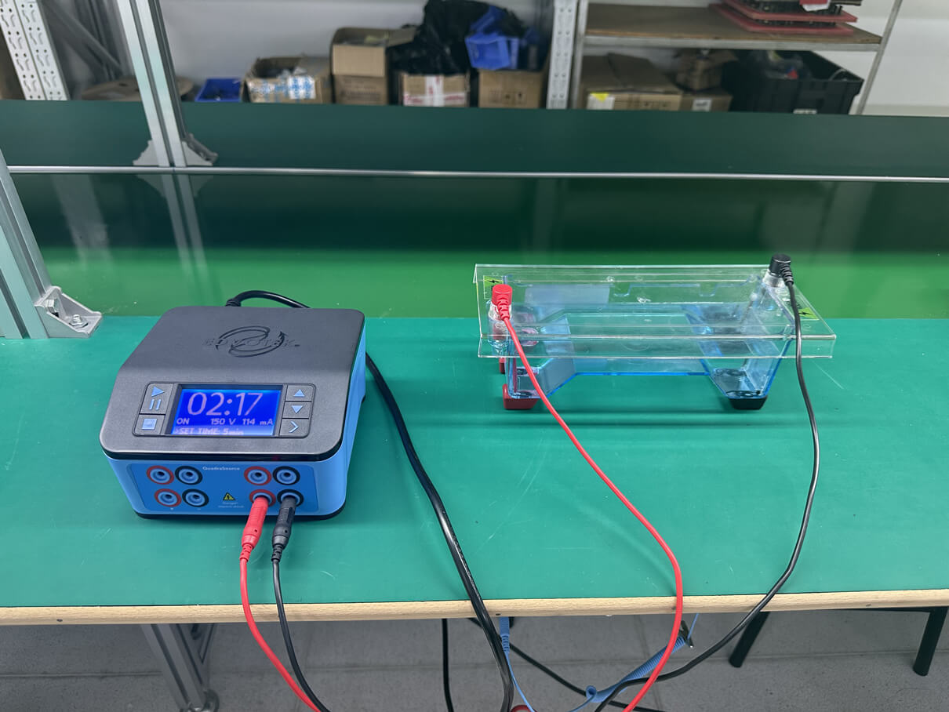
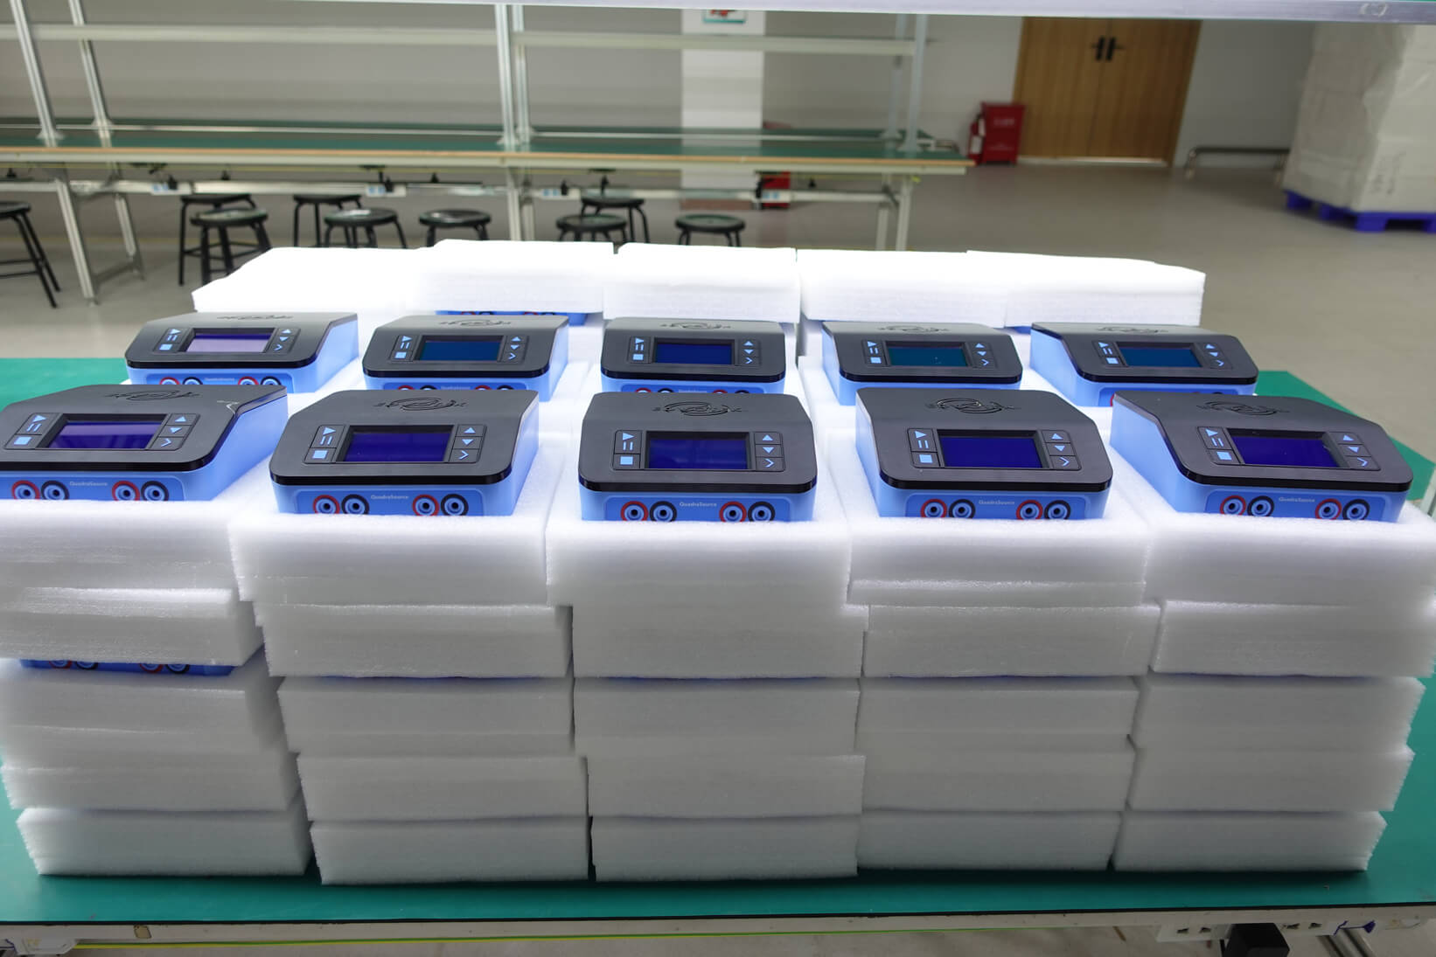

ART 03 -Service Capability /Turnkey product assembly process show
① Assemble LCD display
② Install switch and heat dissipation fan
③ Install the mainboard
④ Connect AC power
⑤ Complete the entire assembly
⑥ Doing FCT test
⑦ Packing the products
⑧ Ready for delivery
11

Slide 12
ART 03 - Service Capability / Quality Control/DFMA service
DFMA service ability
Specification subset category | Device interference analysis | Affiliation
Ass_C2c | Device interference analysis | Assemble
Ass_C2c_Matrix | Safety distance analysis of device package category matrix
Ass _Cooling Plate | Cold plate assembly analysis
Ass_ Fiducial | Optical point analysis
Ass _General | General assembly and process analysis
Ass _Land Pattern(IPC7351) | Design specification analysis of surface mount element pads
Ass_Land Pattern(THI) | Design specification analysis of through - hole device solder pad
Ass_Reflow | Analysis of reflux process specification
Ass_Rework | Maintenance process specification analysis
Ass_Routing | Specification analysis of plate processing technology
Ass _Solder Paste | Upper analysis of solder pad
Ass _Stencil Paste | Technical specification analysis of steel mesh opening
Ass_Thermal | Specification analysis of hot pad
Ass_Wave | Analysis of wave soldering process specification
Ass _Wave Selective | Process specification analysis of tool selective wave soldering
Specification subset category | Specification subset category explain | Affiliation
Fab _BackDrill | Back analysis of drill | Assemble
Fab_Drill | Drilling analysis
Fab _Embedded | Buried device analysis
Fab _Laser Dill | Laser drilling analysis
Fab_ Profile | Molding analysis
Fab _Signal(inner) | Internal circuit analysis
Fab _Signal(outer) | External line analysis
Fab _Signal(P&G) | Power supply and grounding analysis
Fab _Silk screen | Screen printing analysis
Fab _Solder Mask | Resistance welding analysis
Test Point | Test point analysis | Test point
Continuous innovation: Add about 50 rules per year and customize development commitments
Notes:
DFMA 的功能
1，
2，
3，
最后会展示一个我们的DFMA的报告

Slide 13
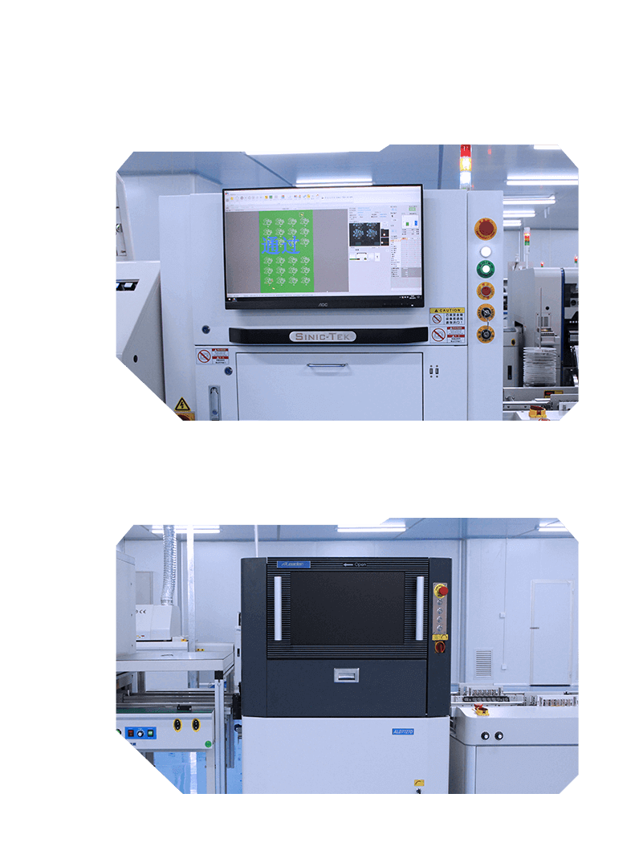
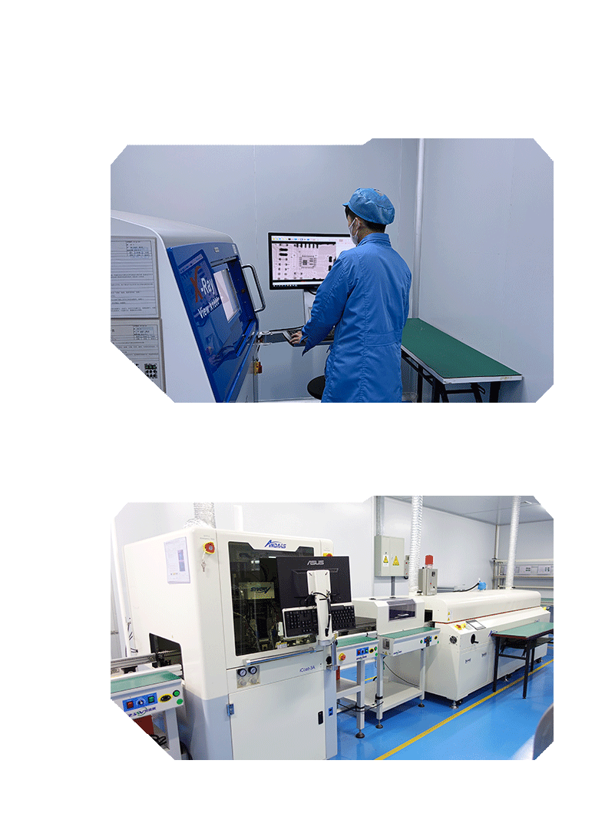
ART 03 - Service Capability /Quality control / In porcess
Online 3D SPI
X-Ray
Online AOI
Conformal-coating
13

Slide 14
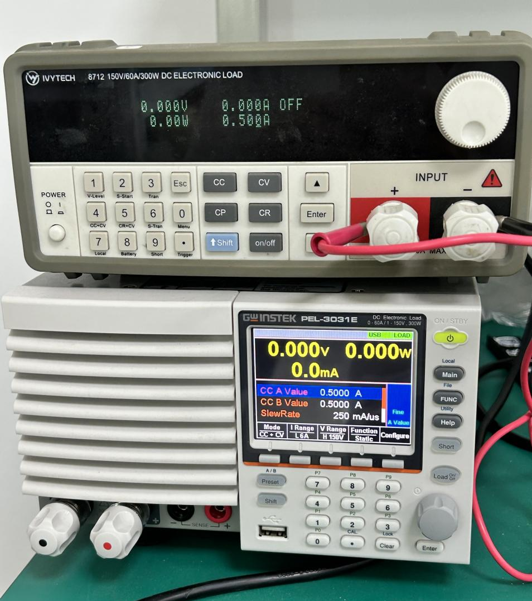
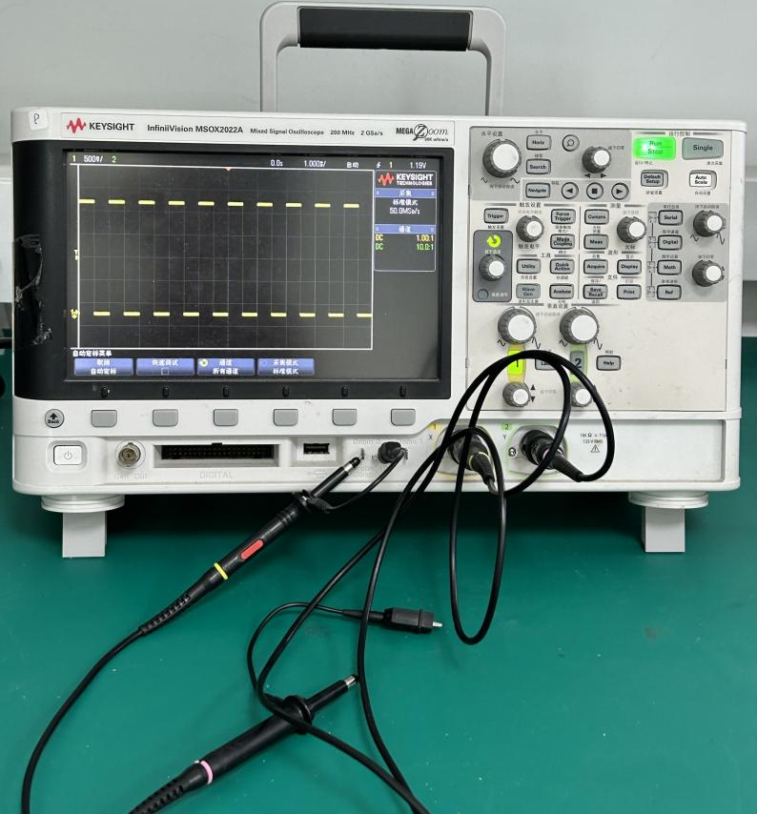
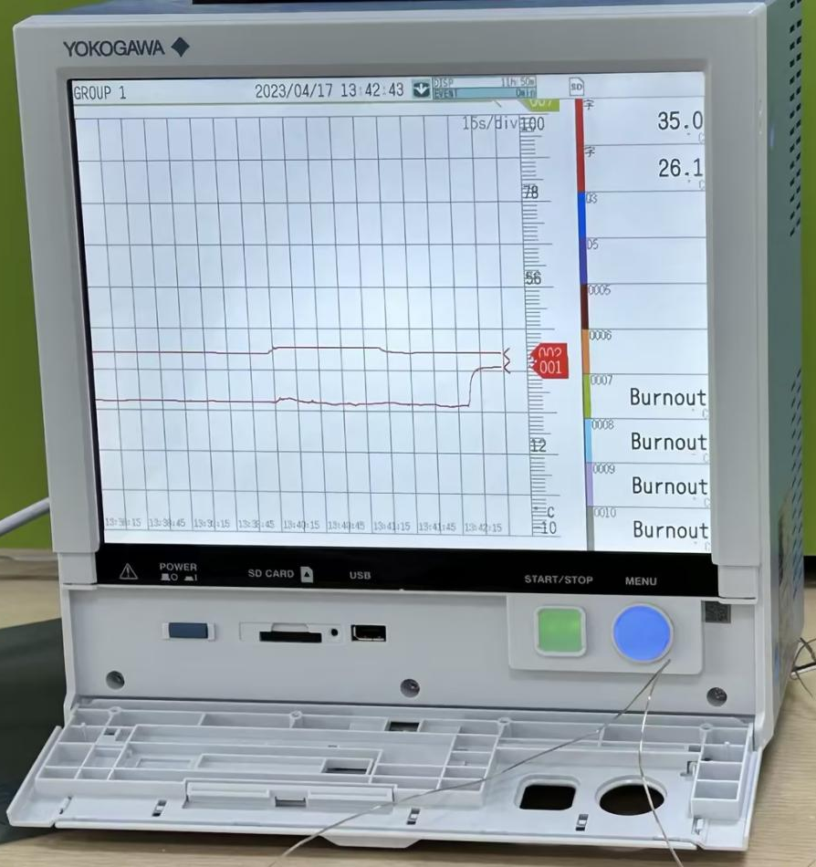
ART 03 - Service Capability / Quality control / FQA
Loading test
Waveform monitoring
Multi -road temperature test
14

Slide 15
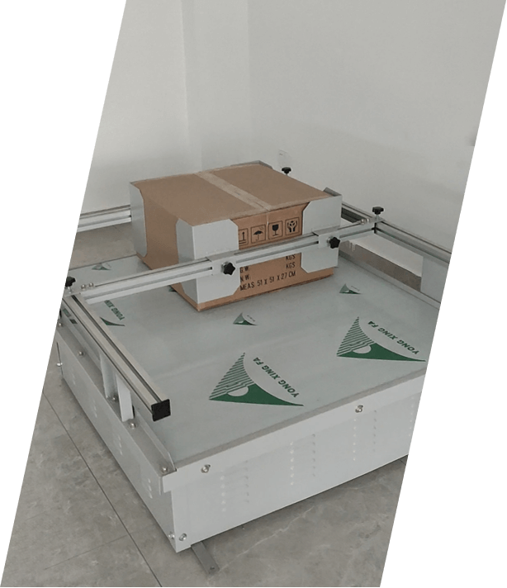
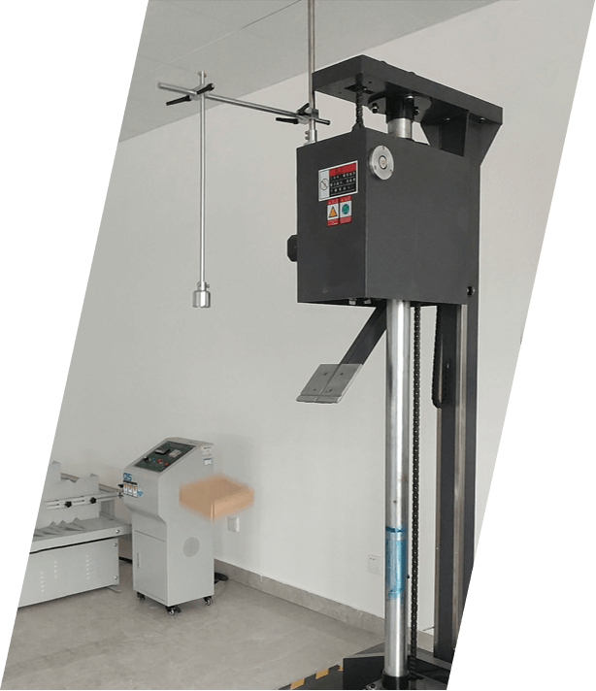
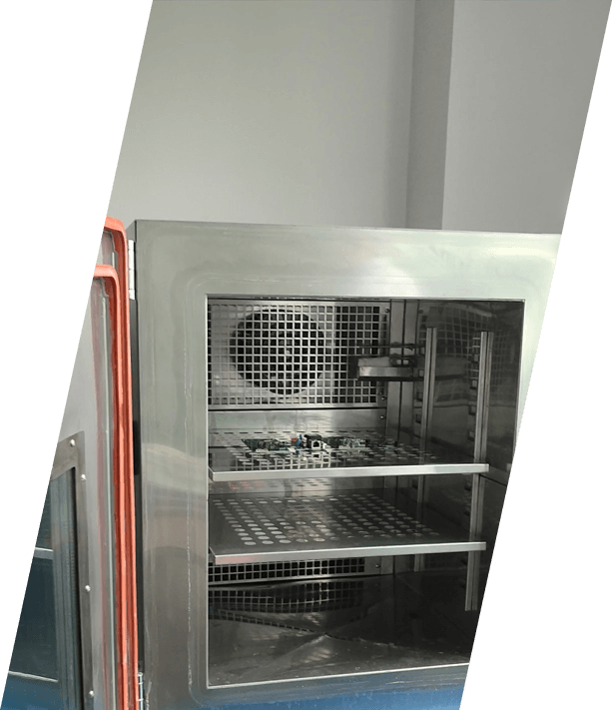
ART 03 - Service Capability / Quality control / Reliability test
Vibration test
Anti - drop test
High and low temperature aging test
15

Slide 16
ART 03 - Service Capability /Our advantages
Owned OEM/EMS factories 14,000 ㎡
10 fully automatic SMT lines
6 DIP assembly lines
3 Turnkey assemby Lines
Complying with IATF, ISO, IPC, UL standards
Equipped with online SPI, AOI, X-Ray inspection machines
The qualified rate of product delivery reached 99.9%
On-time delivery
Quality guaranteed
Professional teamwork
Quick responses
Supply Chain Team Member 20+
Number of engineering team members 22+
With over more than 200+ reliable components suppliers.
2-3 working days to complete the quotation
24 hours pre-sales and after-sales technical support services
Meet all orders’ requirement from sample to volume production
16

Slide 17
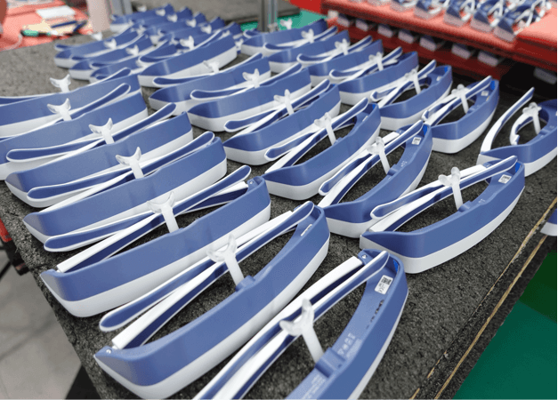
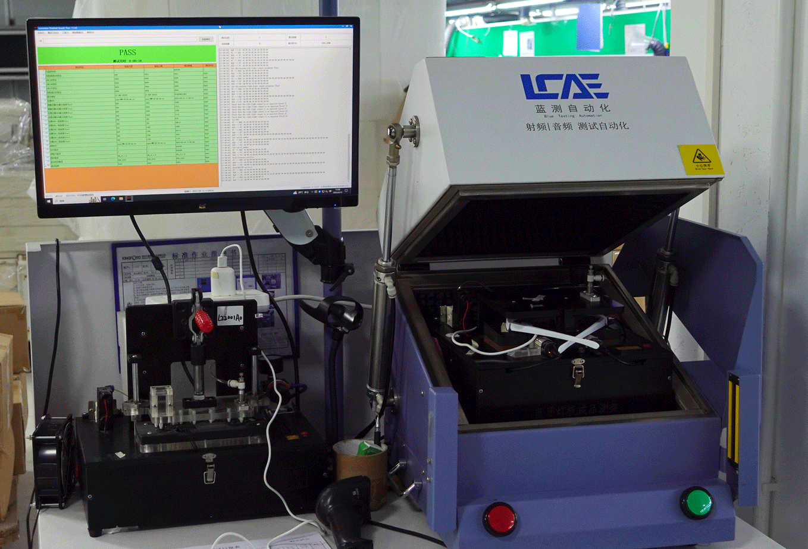

ART 03 –Service Capability /Turnkey assembly example 1
Therapy glasses
17

Slide 18
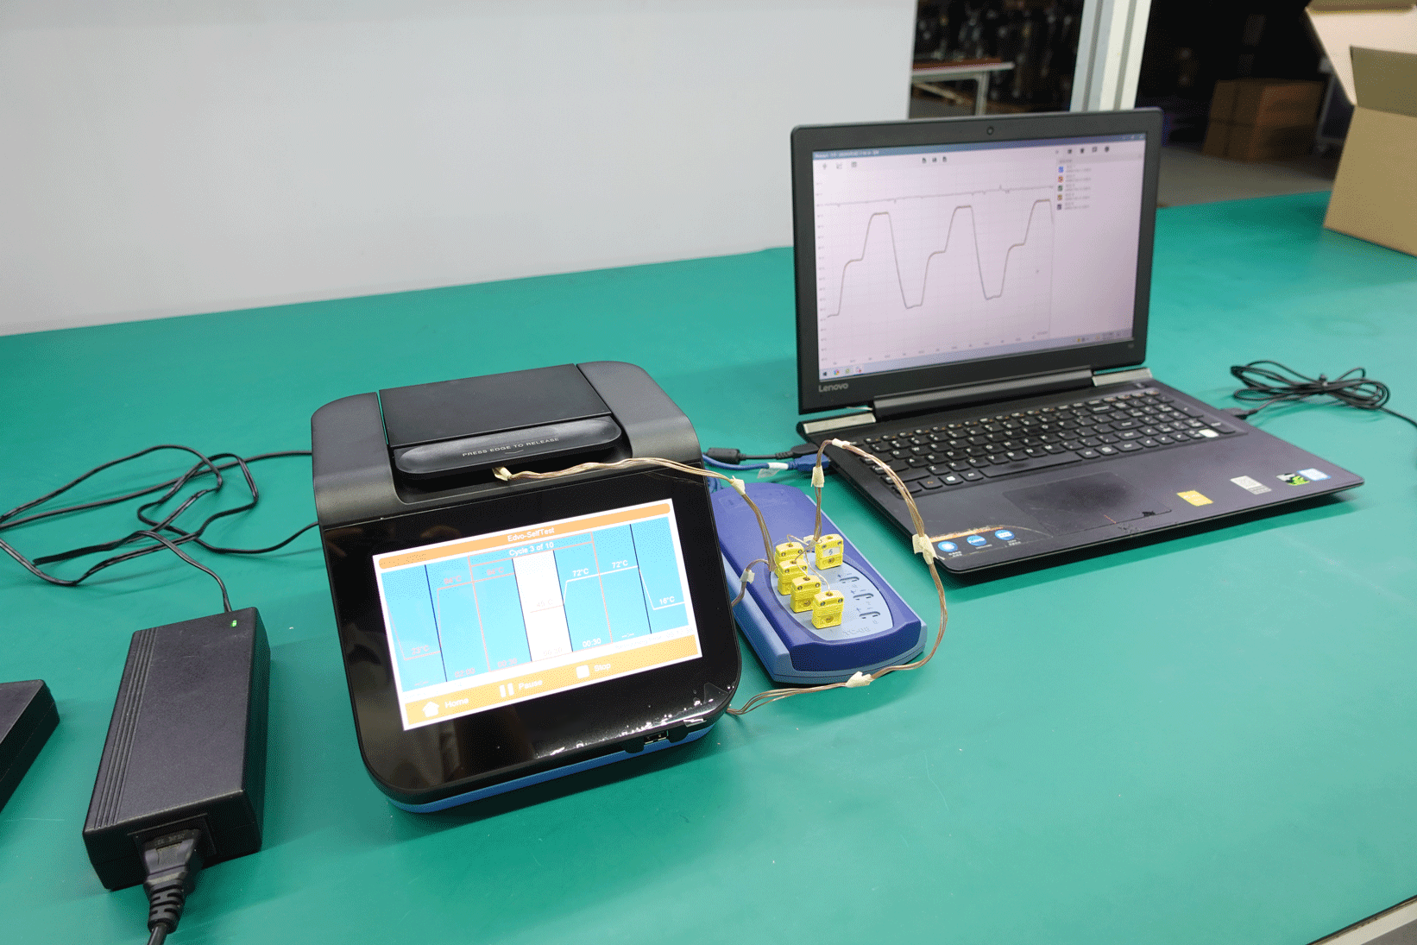
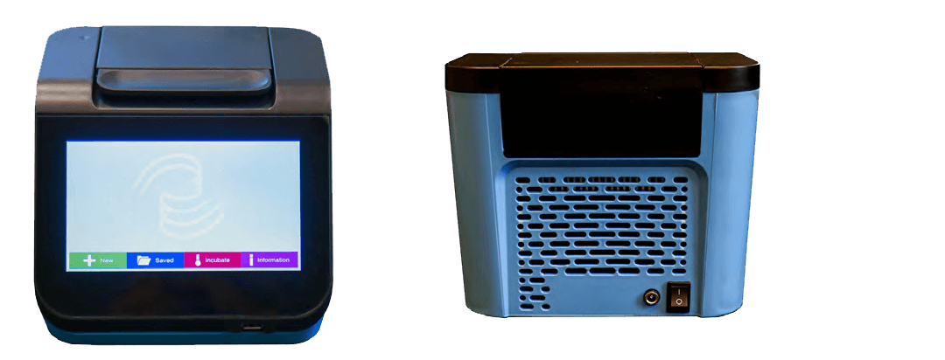
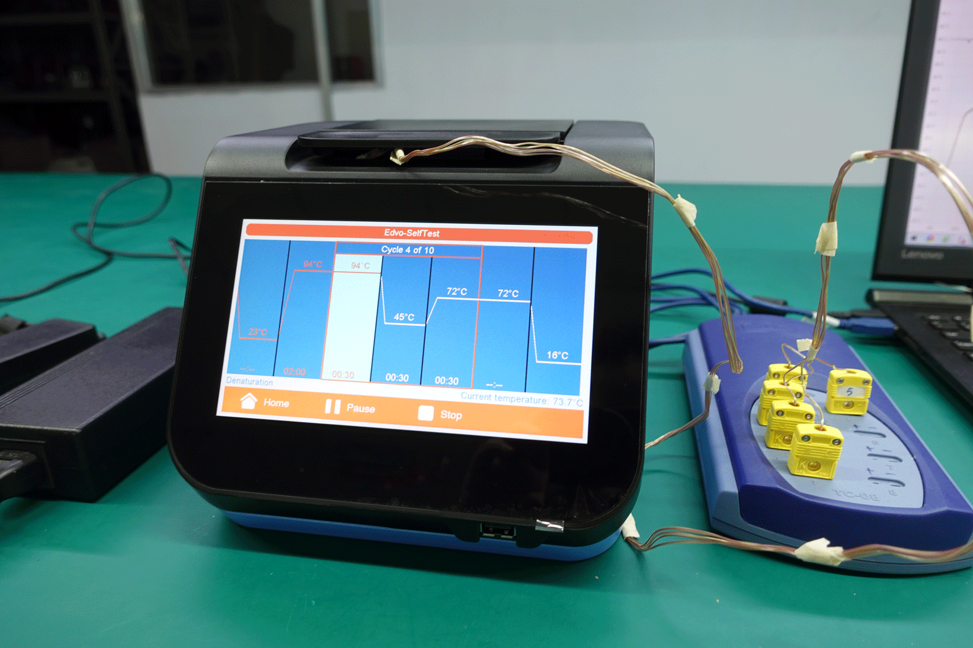
ART 03 - Service Capability /Turnkey assembly example 2
16 Hole Heat Circles
16 -hole thermal circulator performance test
Test point | Range | Minimum | Maximum
45℃ | -0.4℃——+2.5℃ | 44.6℃ | 47.5℃
72℃ | -2.0℃——+1.5℃ | 70.0℃ | 73.5℃
94℃ | -2.5℃——+2.0℃ | 91.5℃ | 96.0℃
18

Slide 19
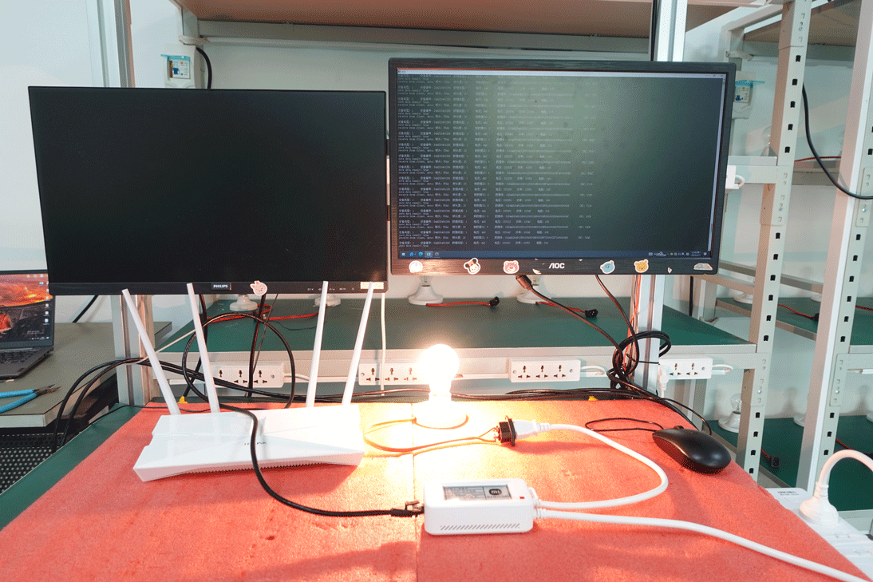
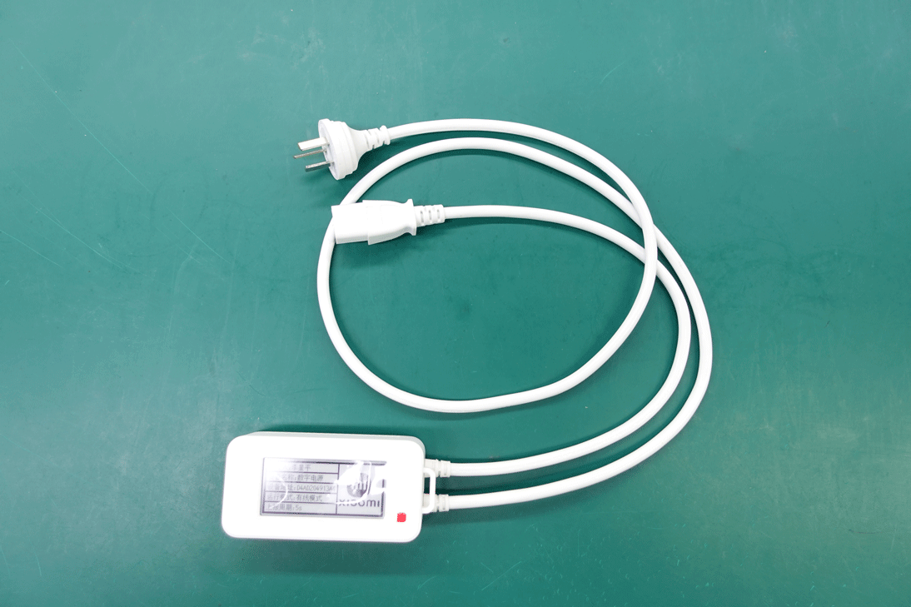
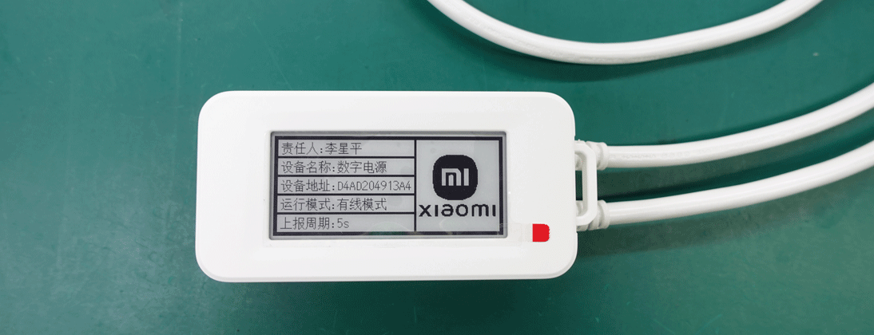
ART 03 - Service Capability /Turnkey assembly example 3
Digital power parameter performance:
Solution: STM32, RTOS
Upgrade method: OTA, suitable for Xiaomi hardware test platform framework
Current: 0.004A-16A
Power: 1W-3600W
Work temperature: -20 ° C ~ 80 ° C
Installation method: 3M glue fixation+hinge fixing
Wired mode: TCP Client, binding the MAC address direct connection
Wireless mode: Support 2.4GHzwi-F
Pressing: Long press for 5 seconds of Reset
Product size: 40mm × 60mm × 100mm

Slide 20
Thank you !
Looking forward to working with you!

